Slide 1
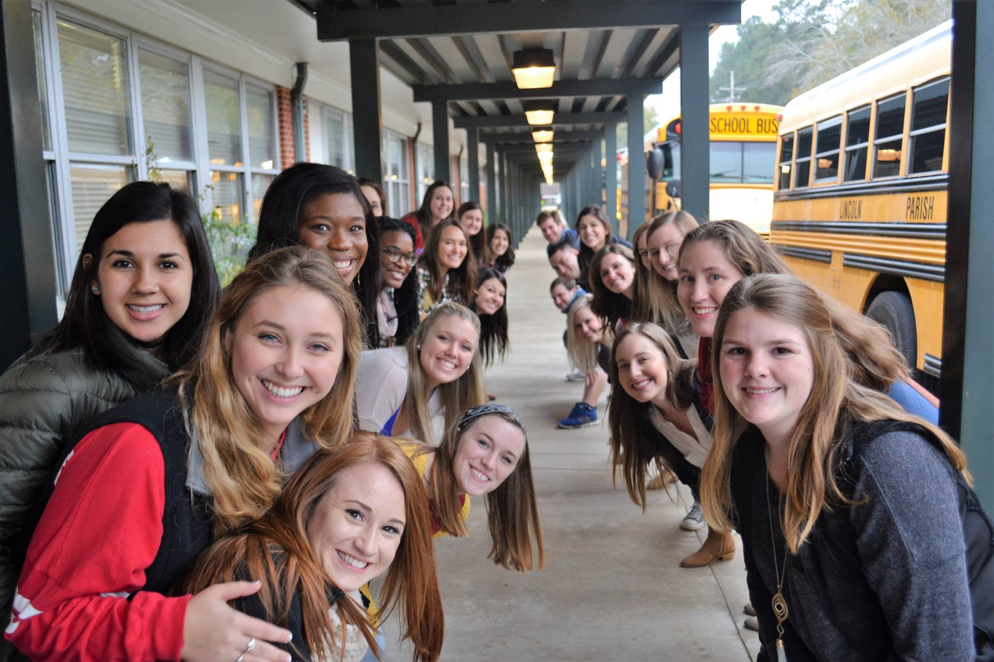
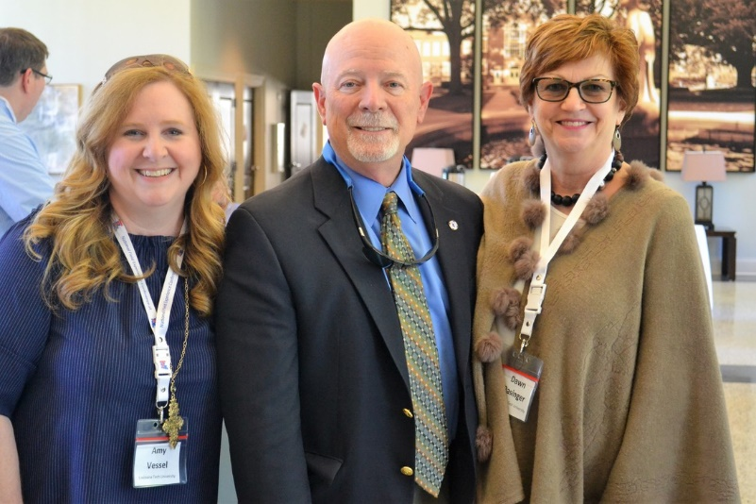
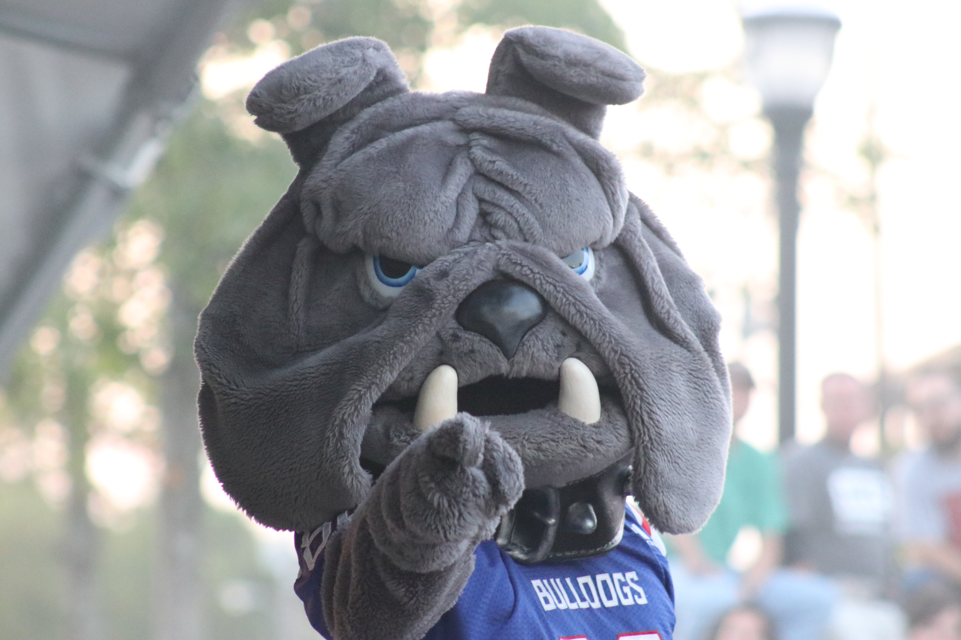
Welcome!
Latechcrrc.org

Slide 2
Professionalism
Latechcrrc.org

Slide 3
Social Media
1. Facebook
2. Instagram
3. Twitter
@latechcrrc
Email Check Daily all quarter!

Slide 4
Praxis Exams Interested in additional certifications? Now is the time to add!

Slide 5
Professional Dress Follow School System Policies Ask your Mentor Motto: “If In Doubt, Don’t!”

Slide 6
Communication Plan w/Mentor Swap contact information with your mentor and co-establish a regular meeting plan. You will need that support all year!

Slide 7
Communication Plan w/others 1. Always use academic language and refer to your mentor with respect. 2. All emails should be formally written with signatures. 3. Always refer to all authority by formal name. 4. No specific conversations about your students to others.

Slide 8
Questioning Tips 1. Make a daily list. 2. Some will be answered for you throughout the day, especially if you read over guidelines, curriculum materials, etc. 3. Prioritize your questions. 4. Establish a time daily that you may ask questions.

Slide 9
Media 1. No photographs of students on social media or on your phone. 2. No video on social media or shared with others. (No video allowed in Lincoln Parish.) 3. No social media connections with students or their families.

Slide 10
Professional Development

Slide 11
Generational Differences
Copyright 2016, The Clinical Residency & Recruitment Center,
Dr. Amy Vessel & Dr. Dawn Basinger, Louisiana Tech University, College of Education

Slide 13
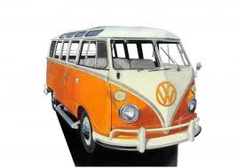
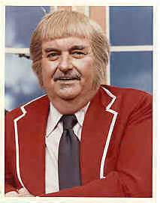
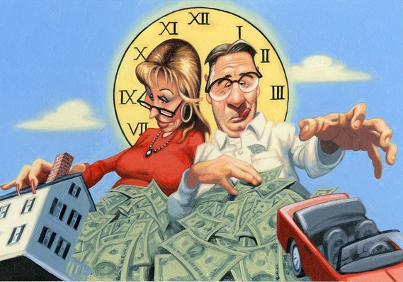
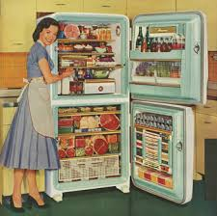
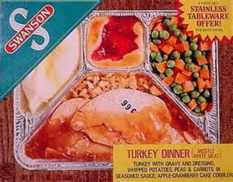
Baby Boomers
1946 - 1964

Slide 14
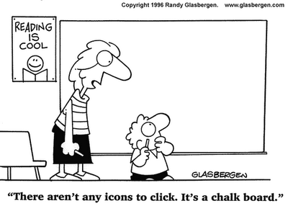

Slide 15
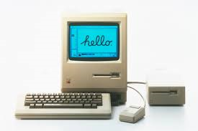
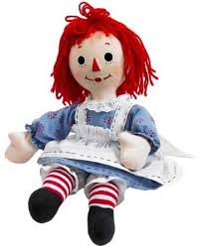
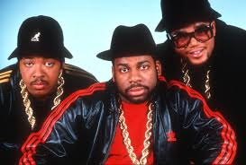
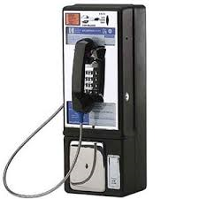
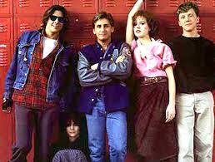
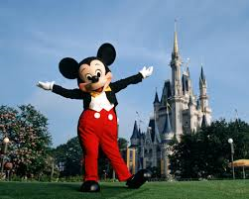
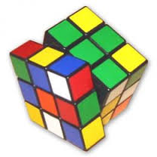
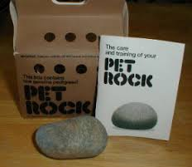
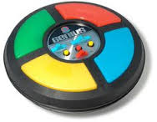
Generation X
1965-1980

Slide 16
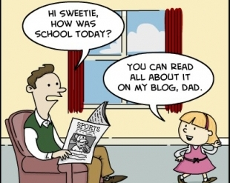

Slide 17
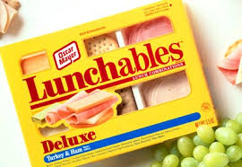
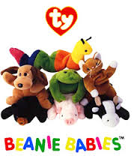
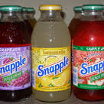
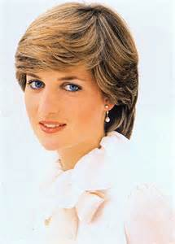
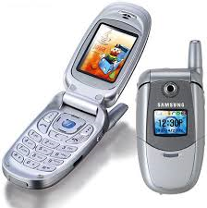
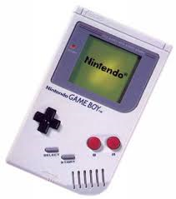
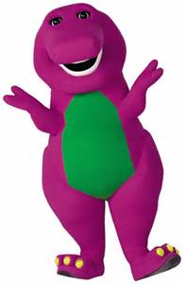
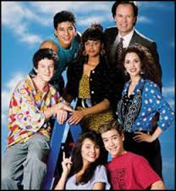
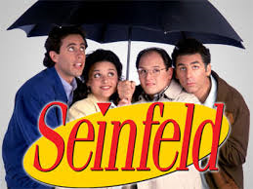
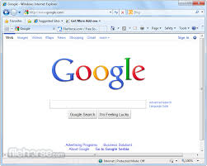
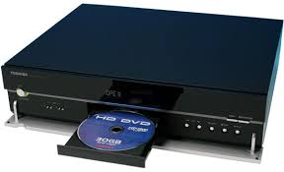
Gen Y
Millennials
1980 - 1994

Slide 18
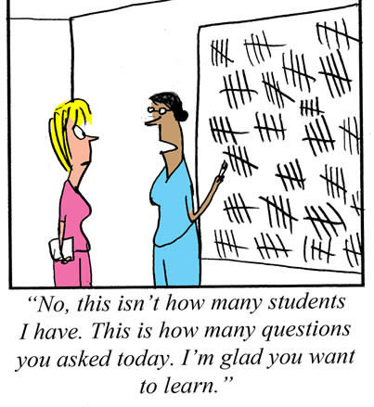

Slide 19
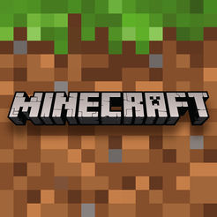
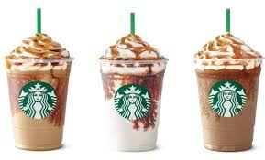
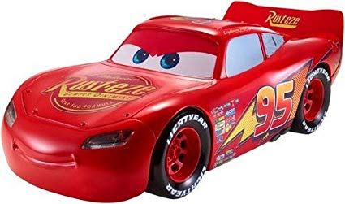
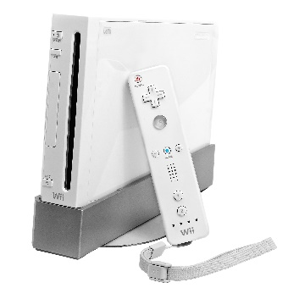
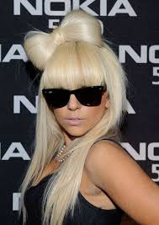
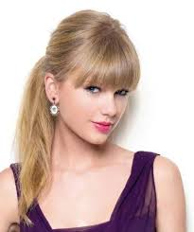
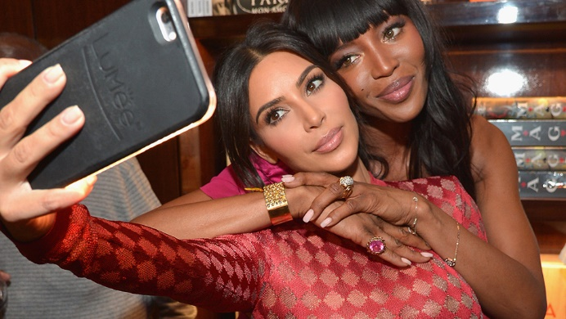
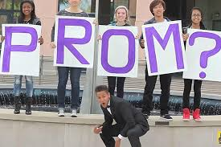
Gen Z
1995-2012ish

Slide 20
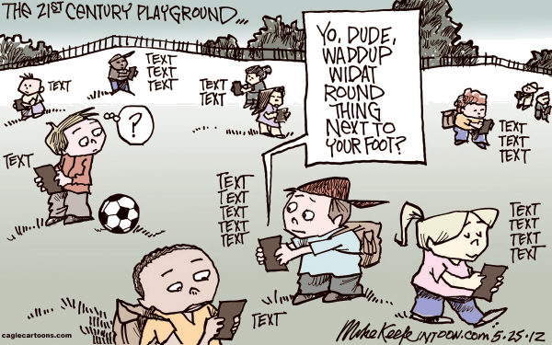

Slide 21
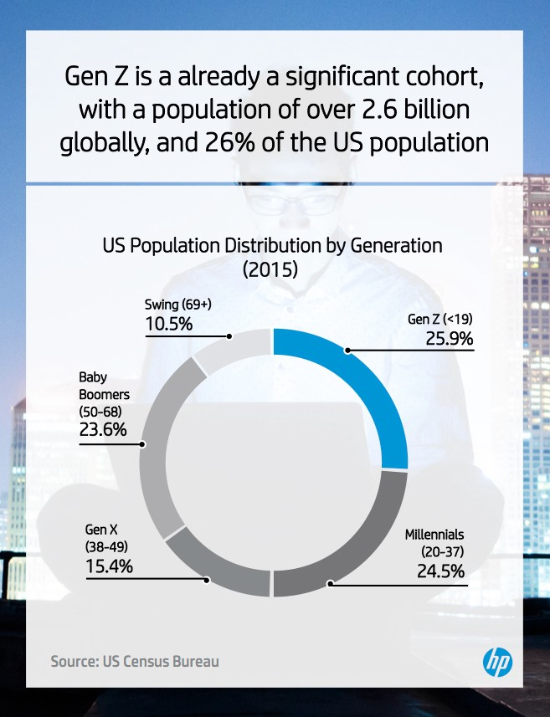
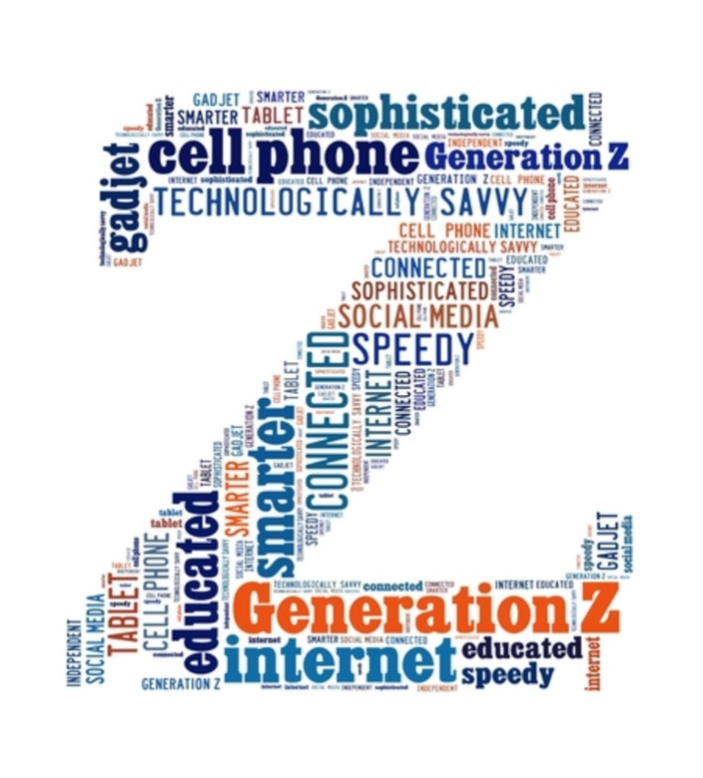

Slide 22
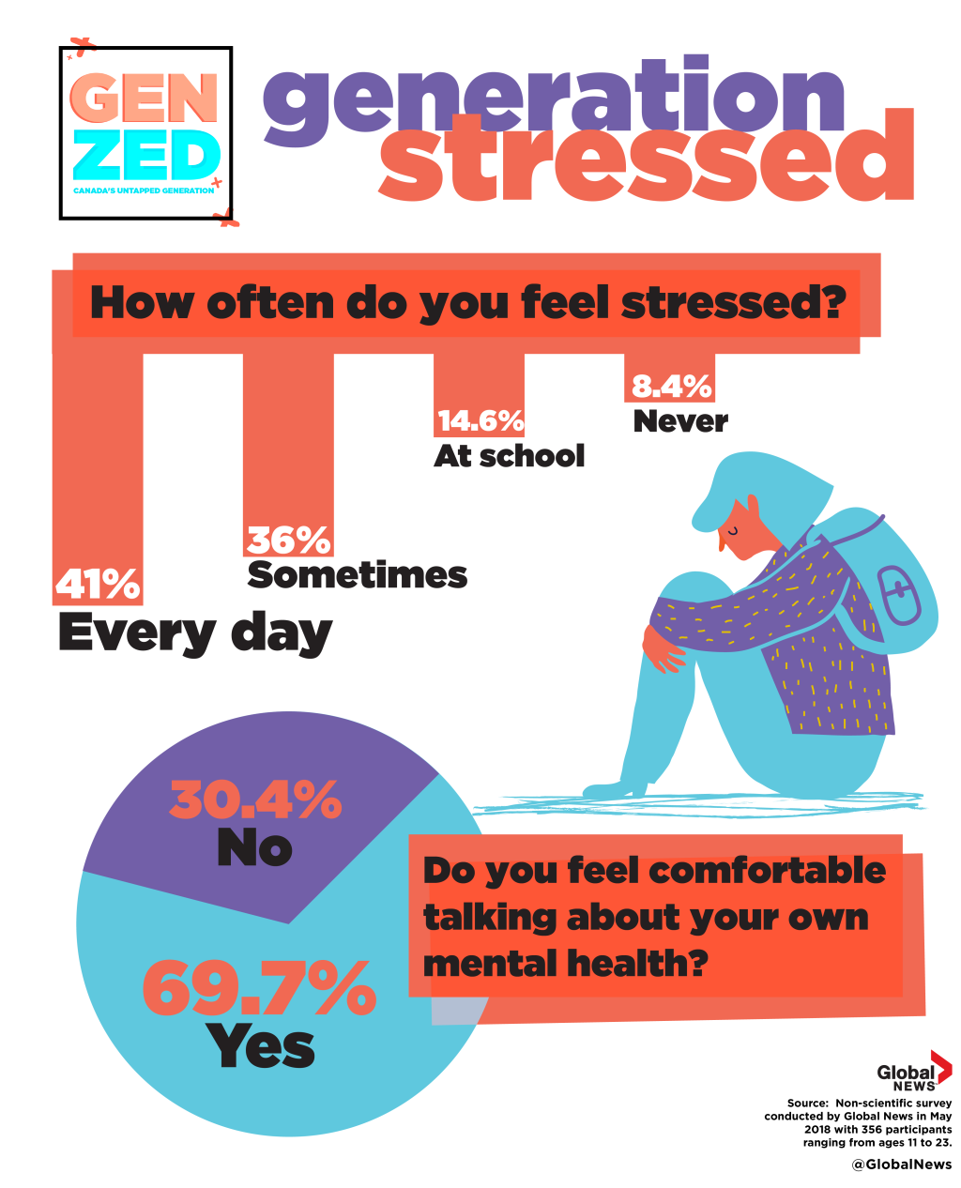

Slide 23
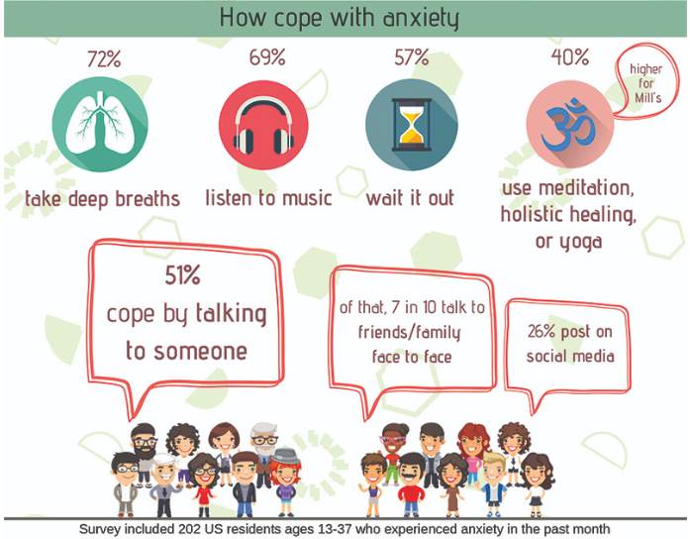

Slide 24
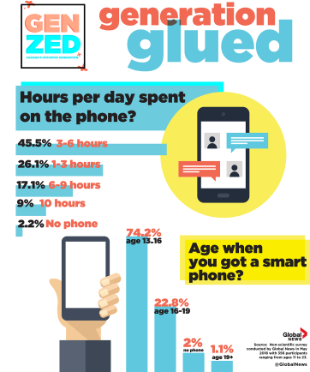

Slide 26
GEN Z | Millennials (Gen Y)
Realists | Optimists
Social Natives | Digital Natives
Create Stuff – want own workspace | Share Stuff – assemble desks in circle
Future-Focused | Present-Focused
Tech Savvy – 5 screens at once | Tech Savvy – 2 screens at once
Communication – Images/Emoticons | Communication – Text
Private: more cognizant of privacy, tend to prefer time-bound sharing (snapchat) | Transparent: Share everything – whole life on display
Need detailed instructions | Disregard instructions – ask many questions

Slide 27
Alternative or Differentiated
Stages of Concern for Teacher Candidates
This strategy is built from parallel teaching.
See increase in spring semester.
Used regularly once a trusting relationship has been established between mentor and resident.

Slide 28
Stage One: Pre-Teaching Concerns
There is LIFE after school!

Slide 29
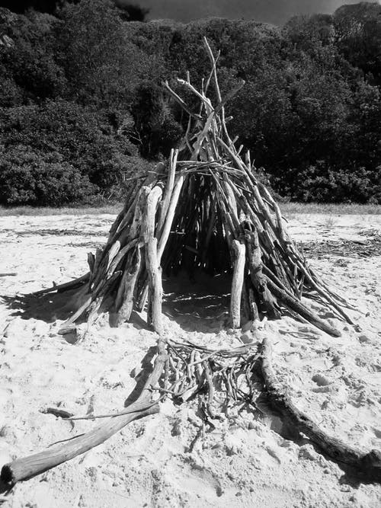
Stage Two: Development of Concerns about Survival

Slide 30
Stage Three: Teaching Situation Concerns
Why Didn’t I pay more attention in those methods classes…
Copyright 2015, The Academy for Co-Teaching and Collaboration at St. Cloud State University and TWH Consulting,
Research Funded by a US Department of Education, Teacher Quality Enhancement Partnership Grant

Slide 31
Final Stage: Concerns about Pupils
Copyright 2015, The Academy for Co-Teaching and Collaboration at St. Cloud State University and TWH Consulting,
Research Funded by a US Department of Education, Teacher Quality Enhancement Partnership Grant

Slide 32
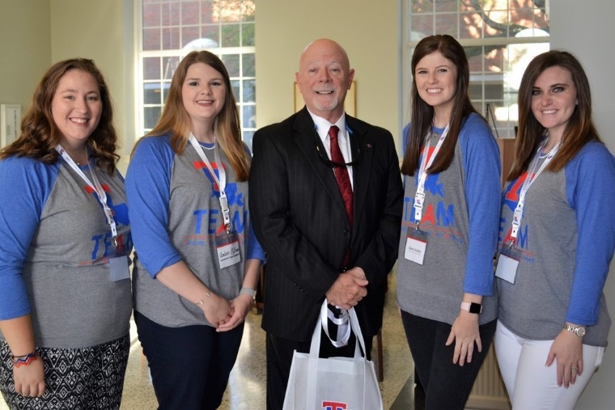
Questions? The College of Education Clinical Residency Center, Louisiana Tech University latechcrrc.org

Slide 33
Forms 1. Scholarship Application 2. Disclosure Form

